Slide 1
Longest Common Subsequence
Problem
  Find the longest common subsequence given two sequences

Slide 2
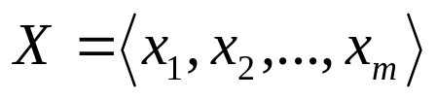
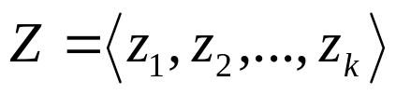
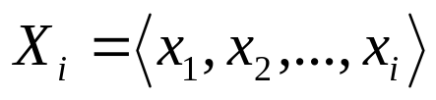
Definitions
Sequence and subsequence
  Sequence
  is a subsequence of X if
  Example Z = <B, D, Y> is a subsequence of
  X = <A, B, C, D, E, F, Y, Z>
Prefix
  The i_{th} prefix of is

Slide 3
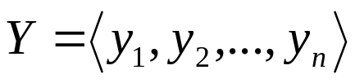
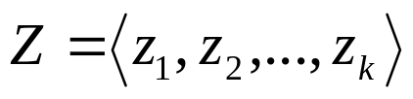
Characterizing an LCS
Let and be sequences and let be any LCS of X and Y
  If x_{m} = y_{n}, then z_{k} = x_{m} = y_{n} and Z_{k-1} is an LCS X_{m-1} and Y_{n-1}
  If x_{m} ≠ y_{n}, and z_{k} ≠ x_{m}, then Z is an LCS X_{m-1} and Y
  If x_{m} ≠ y_{n}, and z_{k} ≠ y_{n}, then Z is an LCS X and Y_{n-1}

Slide 4
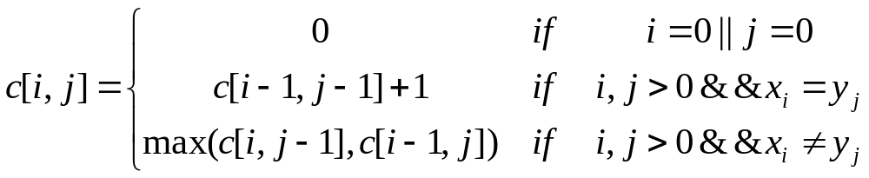
The optimal substructure of LCS
Let c[i,j] be the length of an LCS of the sequences X_{i} and Y_{j}, we obtain the following recurrence

Slide 5
An implementation using dynamic programming
LCS(X, Y)
{
for (i=1; i<=m; i++) c[i][0]=0;
for (j=1; j<=n; j++) c[0][j] =0;
for (i=1; i<m; i++)
for (j=1; j<n; j++) {
if (x[i] == y[j]) {
c[i][j] = c[i-1][j-1] +1;
b[i][j] = ‘’
} else if (c[i-1][j] >= c[i][j-1]) {
c[i][j] = c[i-1][j];
b[i][j] = ‘↑’
} else {
c[i][j] = c[i][j-1];
b[i][j] = ‘←’
}
}
}

Slide 6
Example
0 | 1 | 2 | 3 | 4 | 5 | 6
y | B | D | C | A | B | A
0
1
2
3
4
5
6
7
x
A
B
C
B
D
A
B
0 | 0 | 0 | 0 | 0 | 0 | 0
0 | 0 | 0 | 0 |  1 | 1 |  1
0 | 1 |  1 | 1 | 1 | 2 | 2
0 |  1 | 1 |  2 |  2 | 2 | 2
0 |  1 | 1 |  2 |  2 | 3 | 3
0 |  1 | 2 |  2 |  2 | 3 | 3
0 |  1 |  2 |  2 |  3 | 3 | 4
0 |  1 |  2 |  2 | 3 | 4 |  4

Slide 7
Example
0 | 1 | 2 | 3 | 4 | 5 | 6
y | B | D | C | A | B | A
0
1
2
3
4
5
6
7
x
A
B
C
B
D
A
B

Slide 8
Construct an LCS
In our algorithm, the direction array b tracks the construction
PrintLCS(b, X, i, j)
{
if (i==0 || j==0)
return;
switch (b[i][j]) {
case ‘’:
PrintLCS(b, X, i-1, j-1)
print x[i];
break;
case ‘↑’:
PrintLCS(b, X, i-1, j)
break;
case ‘←’:
PrintLCS(b, X, i, j-1)
break;
}
}

